Slide 1





CUSTOMER CHATBOT FOR E-COMMERCE
SYED FAIZAL N
422521104701
UNIVERSITY COLLEGE OF ENGINEERING VILLUPURAM

Slide 2

OUTLINE
Problem Statement
Who are the end users?
Proposed Solution
System Development Approach
Algorithm & Development
Result
Conclusion
References

Slide 3


PROBLEM STATEMENT
The project aims to develop a customer chatbot solution for an e-commerce platform. This chatbot will assist users with inquiries, provide product information, aid in order tracking, facilitate returns and refunds, and offer personalized recommendations. The goal is to enhance user experience, streamline customer support processes, and boost sales conversion rates on the e-commerce platform.

Slide 4


WHO ARE THE END USERS ?
The end users for our e-commerce chatbot are the customers who visit the e-commerce website or platform. These customers may have various needs and inquiries related to products, services, orders, payments, shipping, returns, and general assistance. The chatbot serves as a virtual assistant to address their questions, provide information, offer recommendations, and facilitate their shopping experience.

Slide 5


PROPOSED SOLUTION
For the chatbot , we're using a neural network built with PyTorch. It has an input layer, two hidden layers with ReLU activation functions, and an output layer. The input layer processes bag-of-words representations of user queries, while the output layer predicts the intent of the query. We're training the model using CrossEntropyLoss and optimizing with the Adam optimizer.We use packages like numpy,torch,nltk(Natural Language Toolkit) , flask and flask-cors. This architecture efficiently handles classification tasks like understanding user queries and providing relevant responses.
01
02
03

Slide 6
SYSTEM DEVELOPMENT APPROACH
1.HARDWARE REQUIREMENTS:
CPU: A modern multi-core CPU (e.g., Intel Core i5/i7 or AMD Ryzen series) would suffice for training smaller models and datasets. But for larger models it may differ.
•
GPU (Optional): Training neural networks can be significantly accelerated using GPUs. For larger models and datasets, it's recommended to use a GPU with CUDA support (NVIDIA GeForce GTX/RTX or NVIDIA Tesla series) to reduce training time.
•
RAM: At least 8GB of RAM is recommended, with more being preferable for handling larger datasets and models efficiently.
Presented By: Olivia Wilson

Slide 7

2.SOFTWARE REQUIREMENTS
PYTHON:
The project is coded using the Python programming language, leveraging its versatility and extensive library ecosystem for efficient development.
NUMPY:
NumPy is a library for numerical computing in Python. It's used here to perform numerical operations and manipulate arrays, particularly in data preprocessing and training data preparation.
NLTK:
NLTK (Natural Language Toolkit) is a library for natural language processing. It's used here for tokenization, stemming, and other text processing tasks.
FLASK:
Flask is a web framework for building web applications in Python. It's used here to create a web server that hosts the chatbot and handles HTTP requests/responses for chat interactions.
TORCH AND TORCH.NN:
These are parts of the PyTorch library, which is a popular deep learning framework. They are used to define and train neural network models.

Slide 8
ALGORITHM & DEPLOYMENT
Neural Network Training Algorithm:
•The neural network model architecture consists of multiple linear layers followed by ReLU activation functions.
•The input to the model is a bag-of-words representation of user queries, while the output is a probability distribution over different intents (tags).
•During training, the model is optimized using the CrossEntropyLoss function and the Adam optimizer.
•The training process involves iterating over the dataset for a certain number of epochs, where each iteration involves a forward pass to compute the predicted outputs and a backward pass to compute gradients and update the model parameters.
Prepare the Trained Model and Data:
•Save the trained model's state dictionary along with metadata (input size, hidden size, output size, tags) to a file (e.g., data.pth).
•Save the intents dataset to a JSON file (e.g., intents.json) containing patterns and tags.

Slide 9
1.Set Up Flask Application:
•Create a Flask application (app.py) with routes for handling chat interactions.
•Load the intents dataset and the trained model from files.
•Define a route (/get_response) to process user queries and return responses.
2.Process User Queries:
•Upon receiving a user query via a POST request to /get_response, tokenize the query and convert it into a bag-of-words representation.
•Feed the bag-of-words representation to the trained model for prediction.
•Use the predicted intent to retrieve a response from the intents dataset.
3.Return Response to User:
•Return the predicted response to the user in JSON format.
4.Run the Flask Application:
•Run the Flask application (app.py) on a web server.
•Users can interact with the chatbot by sending POST requests to the /get_response endpoint with their messages.

Slide 10
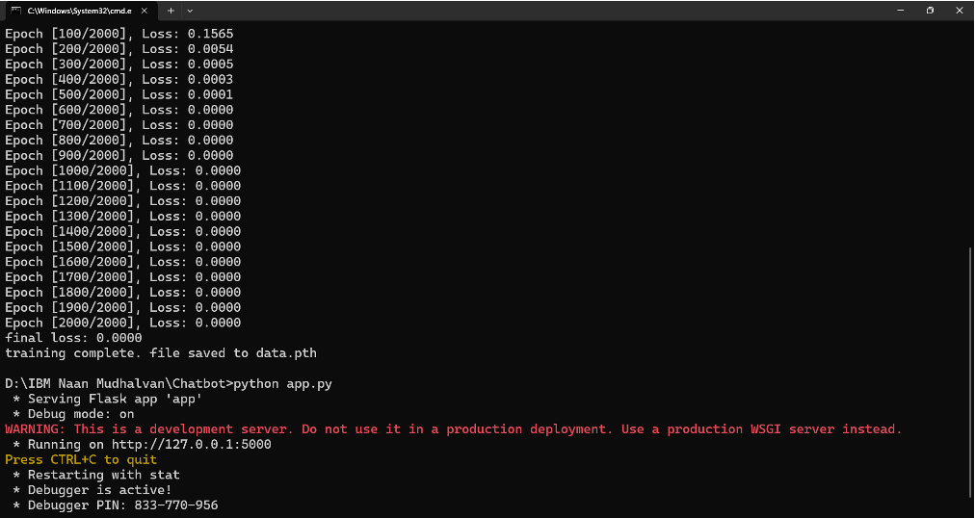
RESULT

Slide 11
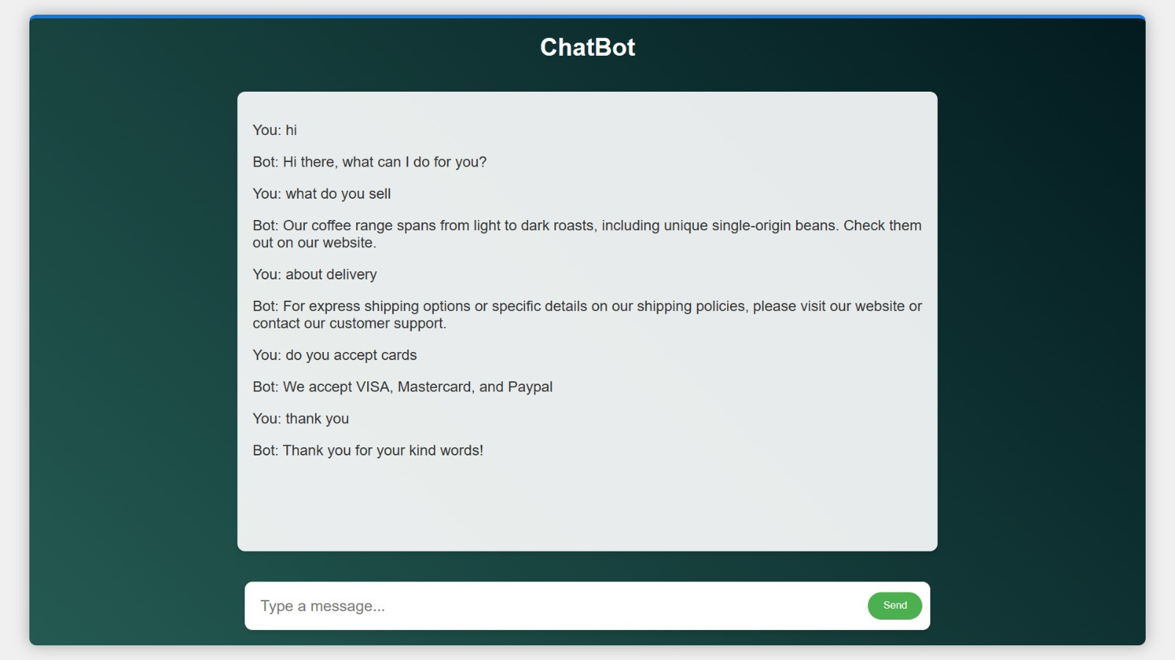

Slide 12

CONCLUSION
In conclusion, this project successfully developed a chatbot fore-commerce using Neural Network.The chatbot was trained on customer’s intent and deployed on a web platform, providing users with a convenient way to interact and seek assistance. Through thorough evaluation, the chatbot demonstrates its capability to deliver helpful responses and improve the overall shopping experience for customers.

Slide 13

REFERENCES
https://numpy.org/
https://www.nltk.org/
https://flask.palletsprojects.com/en/3.0.x/
https://www.ibm.com/topics/neural-networks
https://www.ibm.com/blog/chatbot-examples-a-beginners-guide/

